Slide 1
JAVA METHODS

Slide 2
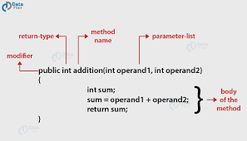
Methods In Java
A method in java is a group of statements which is used to per
form a specific task.

Slide 3
Example Program in Eclipse:
public class Predfn
{
public static void main(String[] args)
{
// using the max() method of Math class
System.out.print("The squareroot is: " + Math.sqrt(9));
}
}

Slide 4
SOLUTION
The squareroot is: 3.0

Slide 5
User-defined method:
Methods which are manually written by the user are called user-defined methods.

Slide 6
Example Program in Eclipse:
public class Division
{
public static void main(String[] args)
{
int num1 = 20;
int num2 = 2;
Division d1 = new Division();
int num3 = d1.div(num1,num2);
System.out.println("The division of num1 and num2 is= " + num3);
}
public int div(int a, int b)
{
int c;
c=a/b;
return c;
}
}

Slide 7
Output:
The division of num1 and num2 is= 10

Slide 8
Exercise:
Find the error in the following program:
public class Mxfn
{
public static void main(String[] args)
{
int num1 = 20;
int num2 = 2;
int num3 = mxf(num1,num2);
System.out.println("The maximum of num1 and num2 is= ", num3);
}
public int mxf ()
{
int c;
if(num1 > num2){
System.out.println("num1 is greater");
c=num1;
}
else{
System.out.println("num2 is greater");
c=num2;
}
return c;
}
}

Slide 9
Correct Code:
public class Mxfn
{
public static void main(String[] args)
{
int num1 = 20;
int num2 = 2;
Mxfn m = new Mxfn();
int num3 = m.mxf(num1,num2);
System.out.println("maximum of two numbers is:"+num3);
}
public int mxf(int a,int b)
{
int c;
if(a > b){
c=a;
}
else{
c=b;
}
return c;
}
}

Slide 10
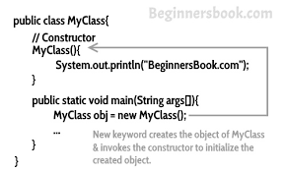
Constructors
Whenever an object is created , the constructor gets called.

Slide 11
Example Program in Eclipse:
public class Human {
int age;
String name;
Human(int a,String n){
age = a;
name = n;
}
void display(){System.out.println(age+" "+name);}
public static void main(String args[]){
//creating objects and passing values
Human h1 = new Human(20,"Mala");
Human h2 = new Human(22,"Kala");
//calling method to display the values of object
h1.display();
h2.display();
}
}

Slide 12
Output:
20 Mala
22 Kala

Slide 13
Exercise:
Write a program to illustrate the use of constructors.
public class Car{
Car(){
System.out.println("New Car");
}
public static void main(String args[]){
Car c = new Car ();
}
}

Slide 14
Instance Variables:
Variables that are declared within the class but outside any method are called instance variables. For instance variables , the memory is allocated at runtime rather than at compile time.

Slide 15
Example Program in Eclipse:
public class Bike {
String Colour;
String name;
public void drive() {
System.out.println("Driving Bike");
}
public static void main(String[] args) {
Bike b = new Bike();
b.Colour = "Red";
b.name = "Pulsar";
System.out.println(b.Colour+" "+b.name);
b.drive();
}
}

Slide 16
Output:
Red Pulsar
Driving Bike

Slide 17
INHERITANCE:
When a childclass inherits the properties of the parent class , then this concept is called as inheritance.

Slide 18
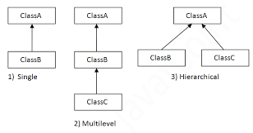
INHERITANCE:

Slide 19
Example
class Employee3{
float salary=40000;
}
class Programmer extends Employee3{
int bonus=10000;
public static void main(String args[]){
Programmer p=new Programmer();
System.out.println("Programmer salary is:"+p.salary);
System.out.println("Bonus of Programmer is:"+p.bonus);
}
}

Slide 20
OUTPUT
Parrots are screeching
flying

Slide 21
MULTI-LEVEL INHERITANCE
class Animal{
void eat(){System.out.println("eating...");}
}
class Dog extends Animal{
void bark(){System.out.println("barking...");}
}
class BabyDog extends Dog{
void weep(){System.out.println("weeping...");}
}
class TestInheritance2{
public static void main(String args[]){
BabyDog d=new BabyDog();
d.weep();
d.bark();
d.eat();
}}

Slide 22
Hierarchical Inheritance:
Example Program in Eclipse:
class Bird{
void fly(){System.out.println("Birds are flying");}
}
class Parrot extends Bird{
void screech(){System.out.println("Parrots are screeching");}
}
class Peacock extends Bird {
void scream(){System.out.println("Peacocks are screaming");}
}
public class ExInherit1{
public static void main(String args[]){
Peacock c = new Peacock();
c.scream();
c.fly();
}}

Slide 23
Output:
Peacocks are screaming
Birds are flying

Slide 24
What is Internship????
Learn
Practice
Verify
Get Certified
Grow

Slide 25
Pantech will make you to create 6 Projects in Java in 30 Days
Objective of this 30 Days Master Class

Slide 26
1 Month Internship in Java Full Stack
INTERNSHIP E-Certificate (30Days Internship on Java Full Stack)
Highly organized Video content
Download Project Files
Download PPTs
Assignments
Weekly Hackathons
Flexible Time.
Access Period: 60Days from the date of payment
Community or Forum Support

Slide 27
What You Will Get???
Project Files of Java
30 Days Learning Practice
Servlet concepts
+ Projects
Erasure Coding(Day 25)
Public Auditing(Day 26)
Counselling Management System(Day 27)
Software Puzzle(Day 28)
Crime Management System(Day 29)
Secure Multi-Owner Data Sharing(Day 30)
Project PPT
Video Class Access for 2 Months
Get chance to Enroll 1-Month Internship on demand

Slide 28
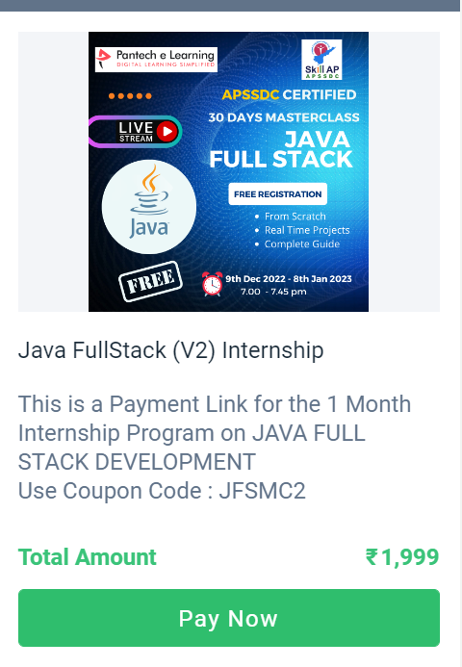
How to Enroll into 1 month Internship?
https://imjo.in/gHNkDr
REG FEE : Rs.1999 Rs.999
COUPON CODE : JFSMC2

